Slide 1



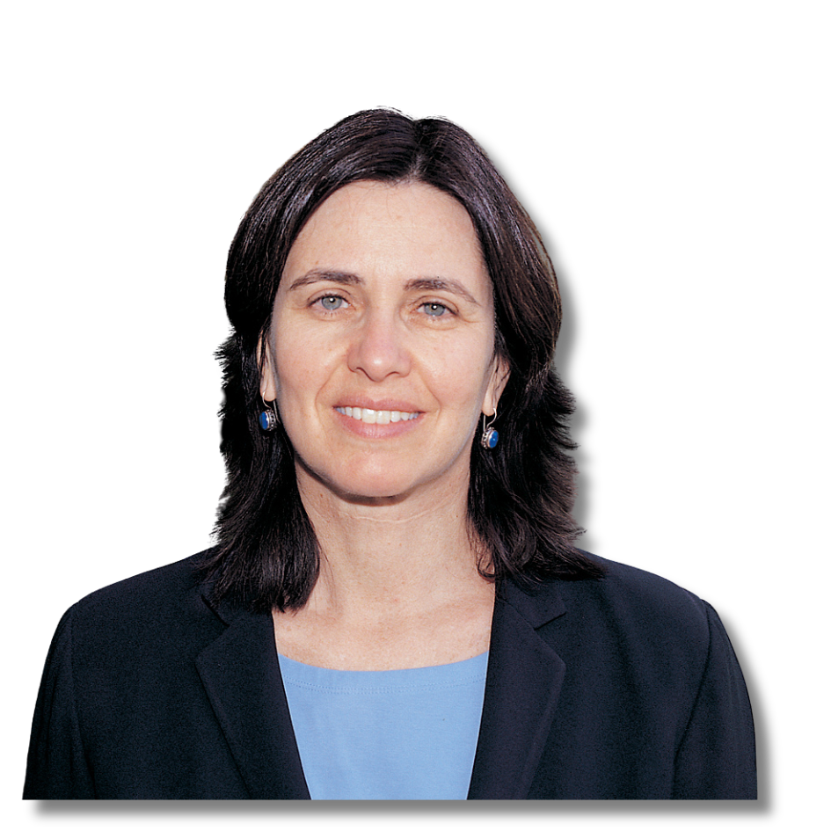
JEWISH AMERICAN
HERITAGE MONTH
ISRAELI AMERICANS WHO CONTRIBUTED TO AMERICA
Shafrira Goldwasser
  Professor of Electrical Engineering and Computer Science at MIT
  Professor of Mathematical Sciences at the Weizmann Institute of Science
  Co-recipient of the 2012 Turing Award for "revolutionizing the science of cryptography"
  Co-founder and chief scientist of Duality Technologies
  Elected member of the National Academy of Engineering for contributions to cryptography, number theory, and complexity theory, and their applications to privacy and security

Slide 2
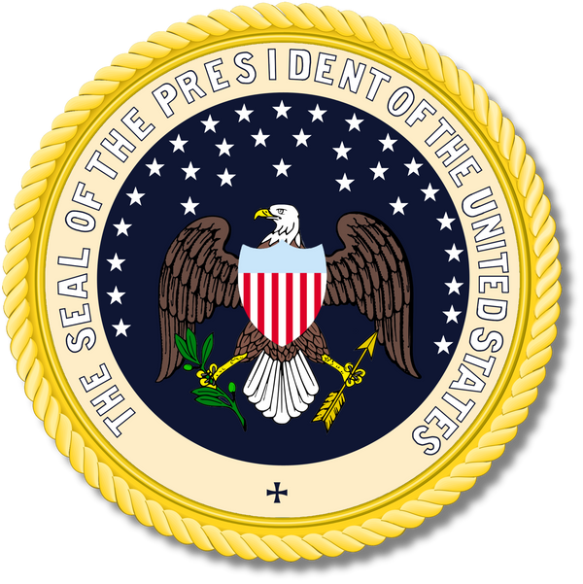

JEWISH AMERICAN
HERITAGE MONTH
ISRAELI AMERICANS WHO CONTRIBUTED TO AMERICA
Rahm Emanuel
  Ambassador to Japan from 2022 to 2025
  Former White House Chief of Staff (2009 to 2010 under President Barack Obama)
  Former mayor of Chicago (2011 to 2019)

Slide 3
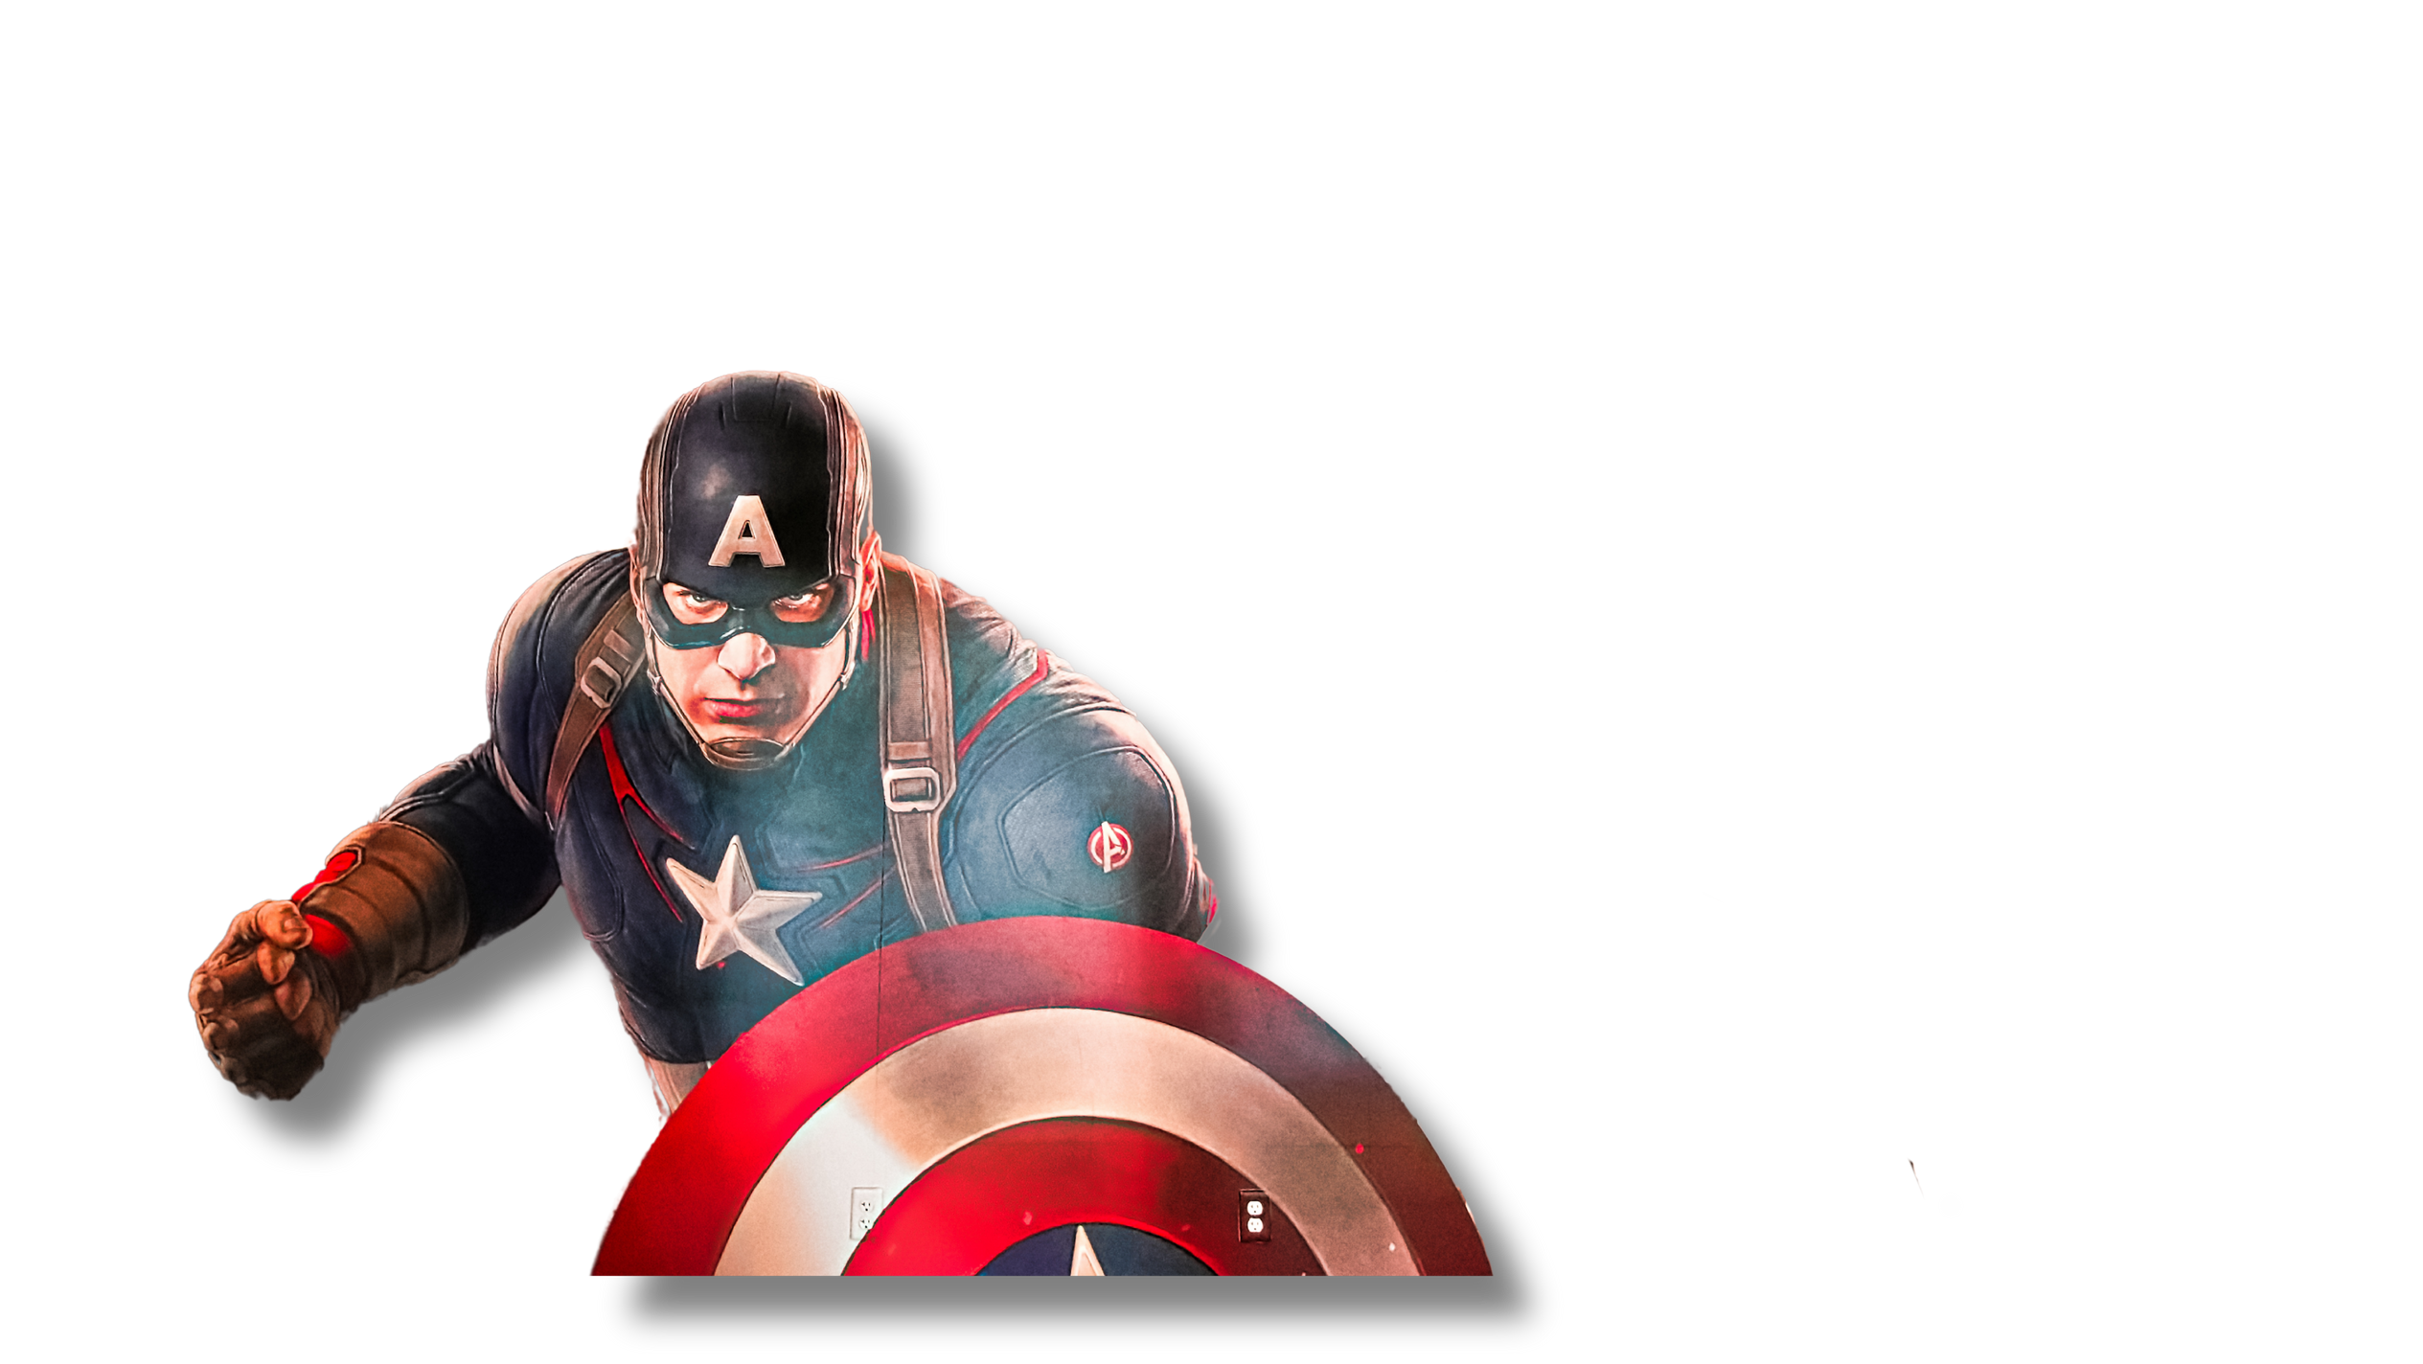
JEWISH AMERICAN
HERITAGE MONTH
ISRAELI AMERICANS WHO CONTRIBUTED TO AMERICA
Avi Arad
  Israeli-American businessman
  Founder of Marvel Studios
  Conscripted soldier of the IDF (Israeli Defense Forces) from 1965-1968, where he was wounded in the 1967 Six-Day War
  The son of Holocaust survivors from Poland, he grew up reading Superman and Spider-Man comics translated into Hebrew.
Photo: AmeriCantaro - stock.adobe.com

Slide 4

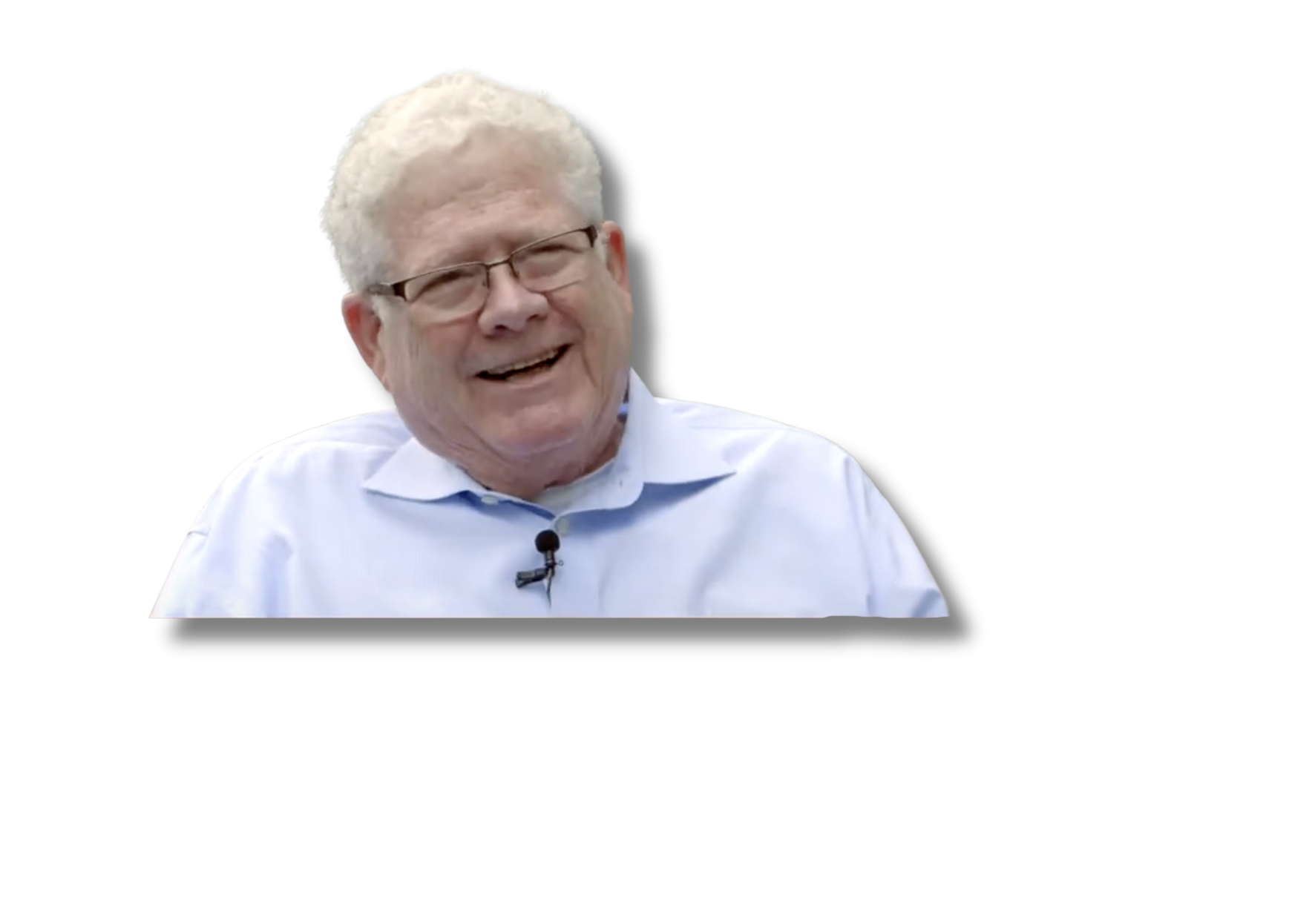
JEWISH AMERICAN
HERITAGE MONTH
ISRAELI AMERICANS WHO CONTRIBUTED TO AMERICA
Ehud Kalai
  Game theorist and mathematical economist
  James J. O’Connor Distinguished Professor of Decision and Game Sciences at Northwestern University
  Founding Editor of Games and Economic Behavior, the leading journal in game theory
  Known for his research on strategic complexity and its implications in economics and political systems

Slide 5
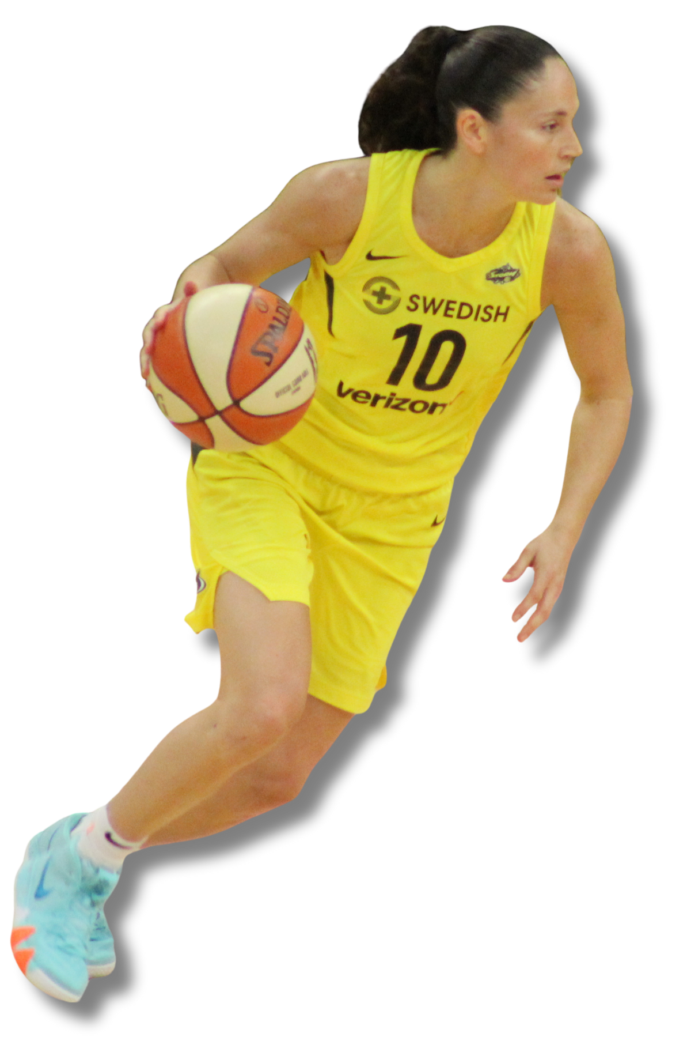
JEWISH AMERICAN
HERITAGE MONTH
ISRAELI AMERICANS WHO CONTRIBUTED TO AMERICA
Sue Bird
  Point Guard for the Seattle Storm
  First overall pick in the 2002 WNBA draft
  Two-time Olympic champion
  Four-time All-Star
  The only WNBA player to win titles in three different decades
  Holds dual citizenship with the U.S. and Israel

Slide 6

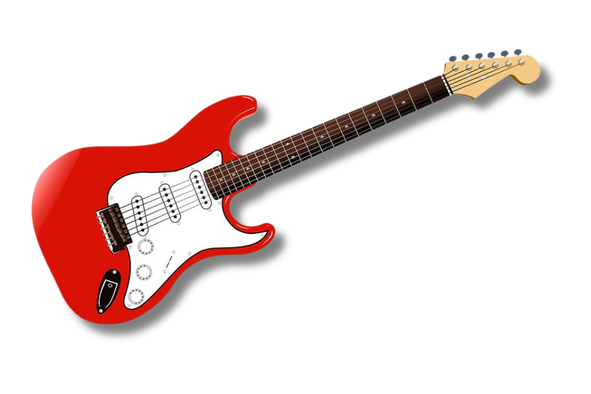
JEWISH AMERICAN
HERITAGE MONTH
ISRAELI AMERICANS WHO CONTRIBUTED TO AMERICA
Este, Danielle,
and Alana Haim
  Grammy-nominated musicians of the rock band HAIM
  Their first album, Days Are Gone, charted in the top ten in several countries, including the number-one spot in the UK.
  Nominated for “Best New Artist” at the 57th Annual Grammy Awards
  Their Israeli-born father Mordechai "Moti" Haim and their American mother Donna were both musicians.

Slide 7
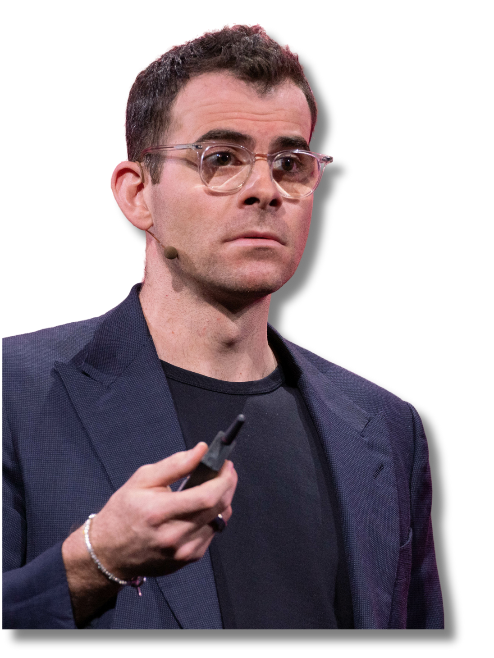

JEWISH AMERICAN
HERITAGE MONTH
ISRAELI AMERICANS WHO CONTRIBUTED TO AMERICA
Adam Mosseri
  Head of Instagram
  Formerly the design director for Facebook’s mobile apps, as well as the Vice President of Product for Facebook
  Mosseri was one of the few Facebook executives who was vocal about Facebook's role in providing security and trustworthy news during the 2018 Cambridge Analytica scandal.
  Mosseri has dual U.S. and Israeli citizenship, as his father is Israeli.

Slide 8

JEWISH AMERICAN
HERITAGE MONTH
ISRAELI AMERICANS WHO CONTRIBUTED TO AMERICA
Haim Saban
  Television and media proprietor notable for his adaptations of Power Rangers
  In 2017, he was honored with a star on the Hollywood Walk of Fame for his achievements in television.
  Saban and business partner Shuki Levy became known for soundtrack compositions for children's television programs of the 1980s, such as He-Man and Inspector Gadget.

Slide 9


JEWISH AMERICAN
HERITAGE MONTH
ISRAELI AMERICANS WHO CONTRIBUTED TO AMERICA
Haviv Rettig Gur
  Journalist at The Times of Israel
  Former Director of Communications for the Jewish Agency
  Born in Jerusalem to American-Jewish immigrants to Israel
  He lived in the United States from age 8 to 28, before returning to Israel to serve in the Nahal Brigade of the IDF (Israel Defense Forces) as a combat medic.

Slide 10
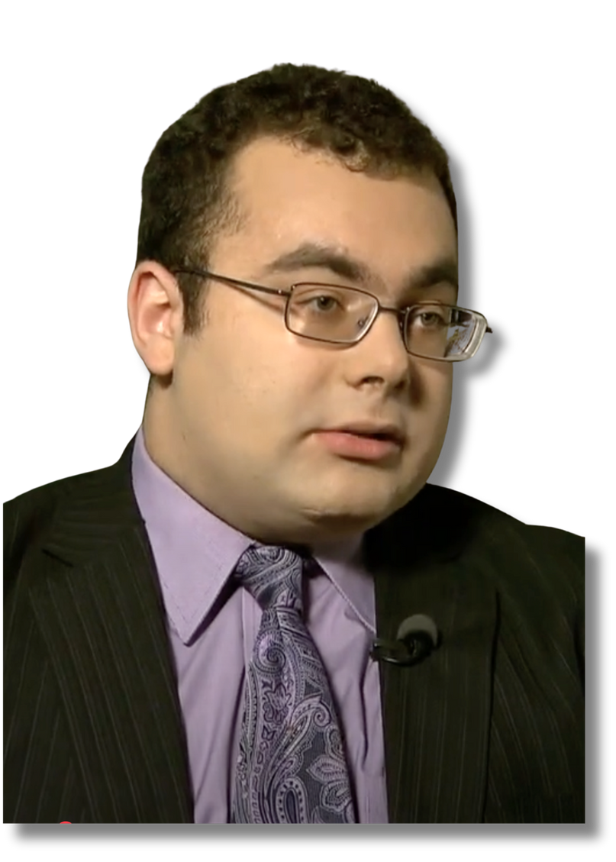

JEWISH AMERICAN
HERITAGE MONTH
ISRAELI AMERICANS WHO CONTRIBUTED TO AMERICA
Ari Ne'eman
  Disability Rights Activist
  Co-founder of the Autistic Self Advocacy Network
  Consultant to the American Civil Liberties Union (ACLU)
  On December 16, 2009, President Barack Obama announced that Ne'eman would be appointed to the National Council on Disability. He chaired the council's Policy & Program Evaluation Committee and became the first person with autism to serve on the council.

Slide 11
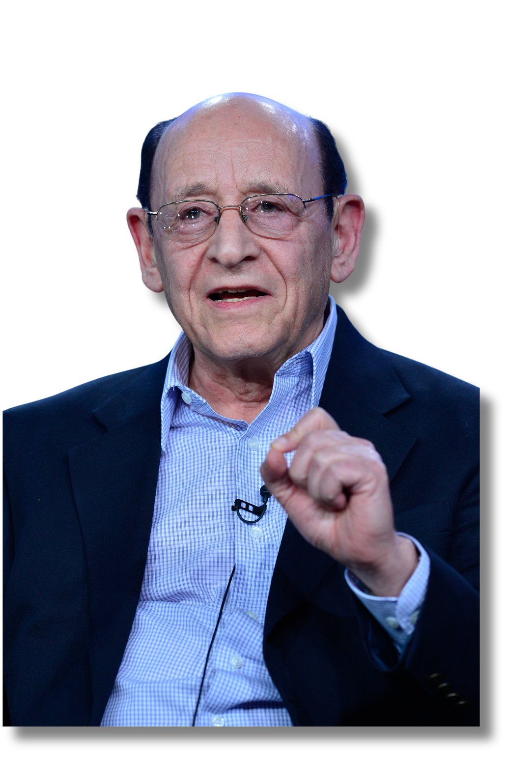
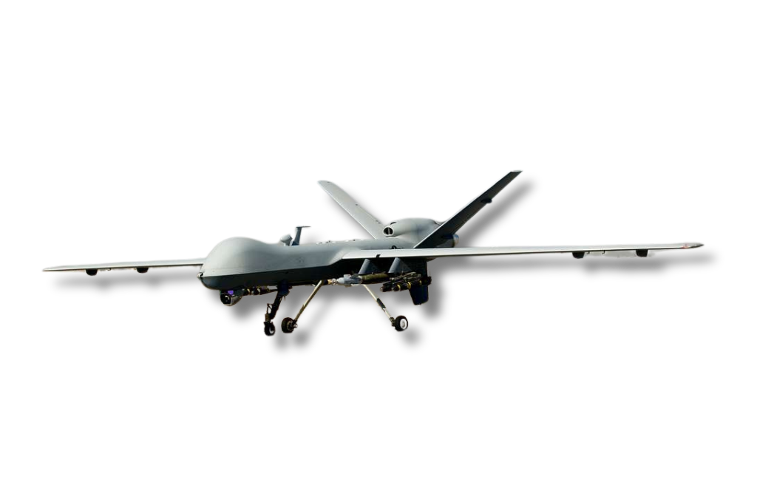
JEWISH AMERICAN
HERITAGE MONTH
ISRAELI AMERICANS WHO CONTRIBUTED TO AMERICA
Abraham Karem
  Inventor of the drone
  Founder of Karem Aircraft
  He built his first drone during the Yom Kippur War for the Israeli Air Force.
  In 2010, Karem was elected a member of the National Academy of Engineering.
  Born in Baghdad to an Assyrian Jewish couple, he moved with his family in 1951 to Israel where he grew up; in the 1970s he immigrated to the United States.
Photo: Rahoul Ghose - PBS

Slide 12

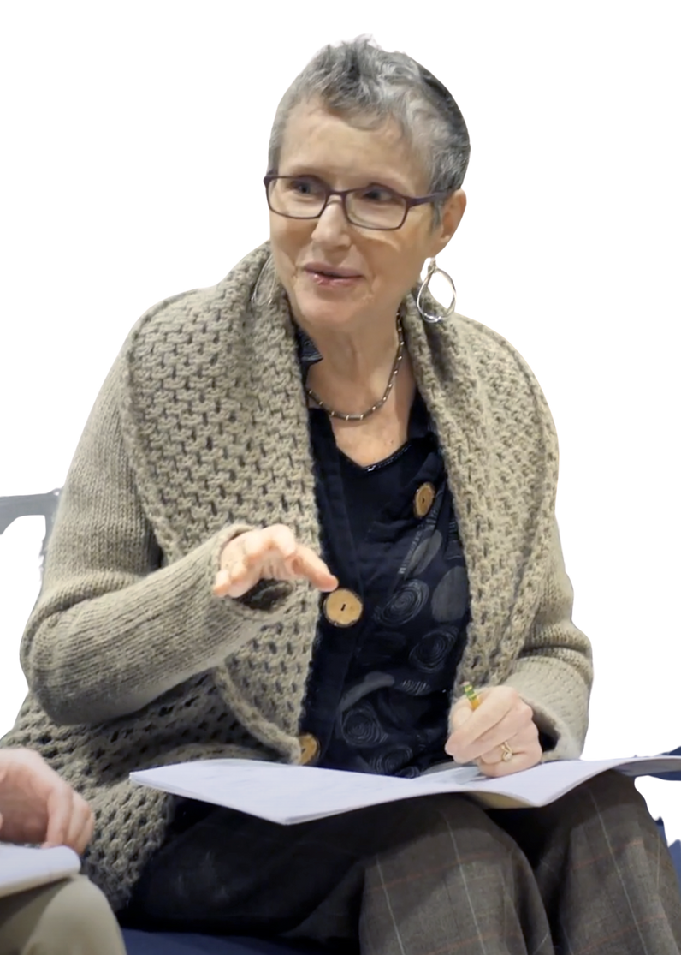
JEWISH AMERICAN
HERITAGE MONTH
ISRAELI AMERICANS WHO CONTRIBUTED TO AMERICA
Shulamit Ran
  Pulitzer Prize winning composer
  Member of the American Academy of Arts and Letters and the American Academy of Arts and Sciences
  As a child, she listened on the radio to Jewish cantorial music, which had an impact on her compositions.
  By the age of nine, she was studying composition with some of Israel's top composers, such as Alexander Boskovich and Paul Ben-Haim.

Slide 13
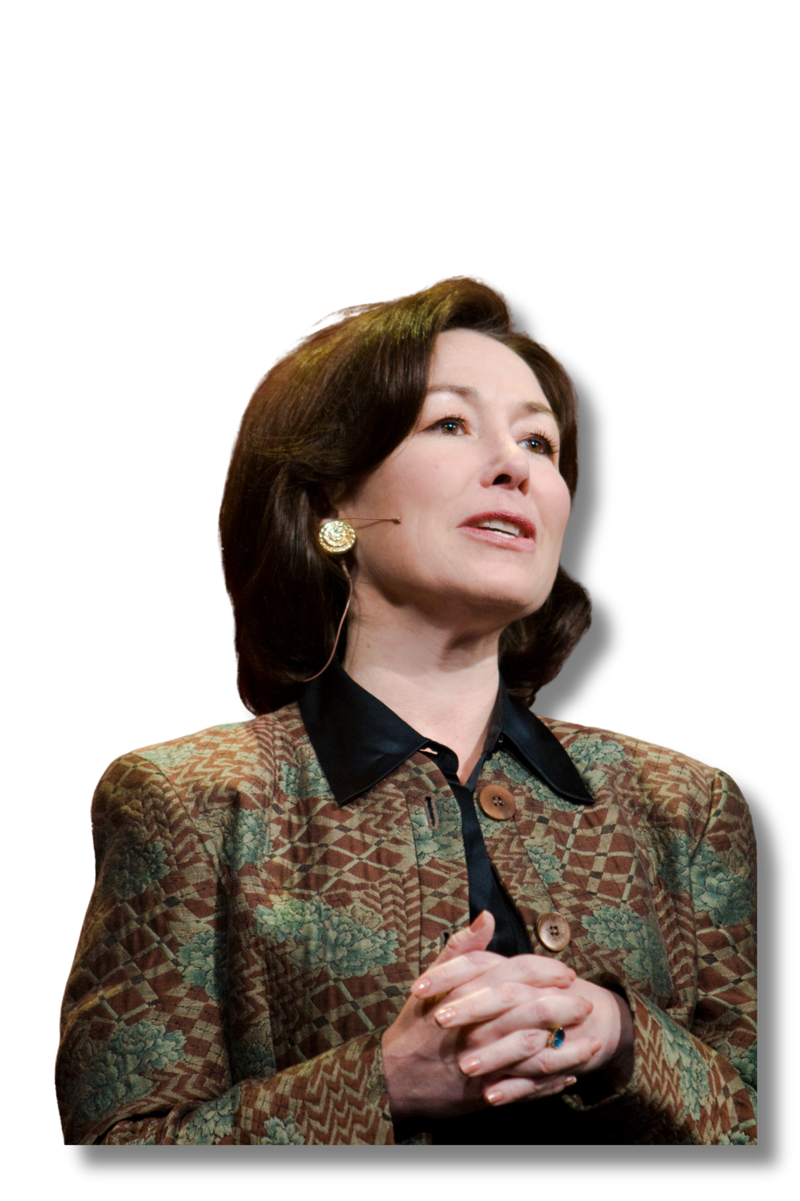

JEWISH AMERICAN
HERITAGE MONTH
ISRAELI AMERICANS WHO CONTRIBUTED TO AMERICA
Safra Catz
  President of Oracle
  Elected to the board of directors of The Walt Disney Company in December 2017
  Member of the National Security Commission on Artificial Intelligence (NSCAI)
  In 2011, she was the highest-paid woman among Fortune 1000 companies according to Fortune magazine.

